Slide 1
Bisphosphonates: 101
What you need to know, and why.

Slide 2
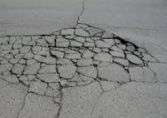
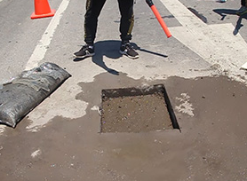
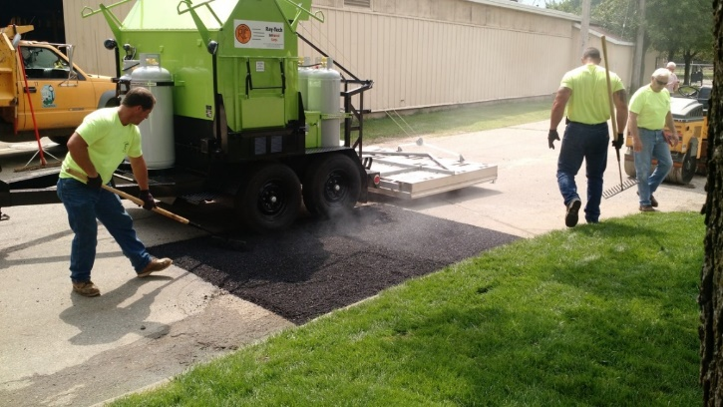
Bone Biology: A Brief Discussion using pavement damage and repair for illustrative purposes
Bone is a dynamic tissue.
Normal, healthy bones experience microfractures on a daily basis.
The occurrence of microfractures in is amplified by high-speed exercise.
Those microfractures are addressed by two types of cells.
Osteoclasts—that clear away damaged bone
Osteoblasts—that build healthy, new bone
Failure of either of these cell lines, or an imbalance in their activity, can result in increased risk of fracture.

Slide 3
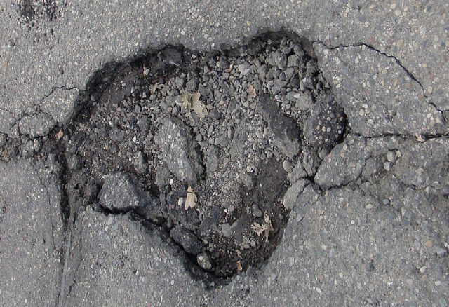
Bisphosphonates: What they do
BPs kill osteoclasts.
The result:
Damaged bone cannot be cleared away
New bone cannot be laid down to repair the defect
BPs have an analgesic (pain relieving) effect.
The mechanism of action for this is not well characterized.

Slide 4
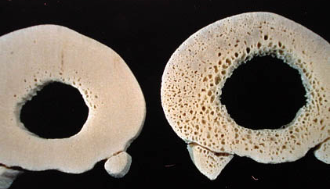
Bisphosphonates in Human Medicine
Prevention of pathologic fractures in post-menopausal women with osteoporosis by decreasing the rate of bone loss—as manifested by osteoclast activity.
Normal Osteoporosis
For geriatric patients:
Fracture risk increases occurs as osteoclast activity outpaces osteoblast activity.
Halting osteoclast activity maintains a more dense, less fragile bone matrix.
For these patients, ‘bad’ bone is better than no bone.

Slide 5
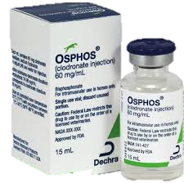
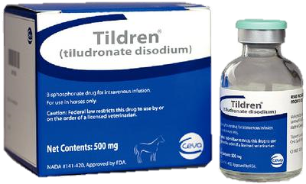
Bisphosphonates in Equine Medicine
Two products, Tildren and OsPhos, have FDA approval for use in the horse.
Label indication: Treatment of navicular disease in horses 4 years of age and older.
Desired effect: Analgesia. (Improved lameness score.)

Slide 6
Off-Label/Extra-label Use of FDA-approved medications
Veterinarians have the legal authority for ‘off/extra-label’ use—the administration of a medication at an alternative dose, by alternative routes, at different intervals, and for treatment of conditions other than those described on the label.
Examples:
Gentocin, an antibiotic, has FDA approval for intrauterine use, yet it is commonly administered intravenously or intramuscularly to treat systemic disease.
The label dose for procaine penicillin is 3,000 IU per pound (10 ml for a 1,000 lb horse) but most veterinarians use a much higher dose.

Slide 7
Off-Label/Extra-label Use of FDA-approved medications
Veterinarians have the legal ability to use bisphosphonates in a manner other than that described on the label.
The fact that their administration to a horse is permissible should not be equated with an endorsement for their off-label use.
The absence of information about their effects in young horse, or for conditions other than navicular disease, represents an unknown risk.

Slide 8
Off-label use of BPs in young horses
There are anecdotal reports of BP administration of to young horses
in sales prep to diminish radiographic evidence of sesamoiditis
thus improving their commercial value.
Defects (channels) in sesamoid bones are the result of osteoclast activity.
If osteoclast activity is interrupted, the channels don’t develop. At least that’s the theory behind the off-label use of BPs in horses in this age group.
If the images are improved does that mean that the horse doesn’t have sesamoiditis?
BPs do not treat sesamoiditis.
Administration with intent to obscure evidence of disease is not a therapeutic use of the medication and does not result in improved health for the treated horse.

Slide 9
Bisphosphonates: The implications of halting osteoclast activity in the young racehorse in training?
Racehorses’ bones MUST remodel and adapt to high speed exercise or they will fail.
Bones adapt most effectively and efficiently in 2-3 year olds. (Bone remodeling does continue throughout the horse’s entire lifetime but at a slower rate.)
If bone is not ‘trained’ during this critical period, the horse is at significantly increased risk of fatal fracture for its entire racing career. This is why, almost counterintuitively, it is much safer for a horse to start its racing career as a 2 year old than to wait to ‘let him grow up’ and initiate training later—when his bones can no longer adequately adapt to the work of racing.
Bisphosphonates administered to young horses in sales prep will exert their effect on osteoclasts during the critical remodeling period.

Slide 10
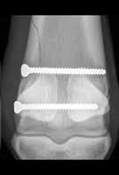
Bisphosphonates and bone healing
A number of equine surgeons have observed fracture healing following surgical repair to be substantially delayed in horses known to have been treated with bisphosphonates.
At a recent meeting, surgeons discussed their personal observations with respect to the duration of effect, and were in agreement that radiographic findings don’t normalize until about 8 months post-treatment.

Slide 11
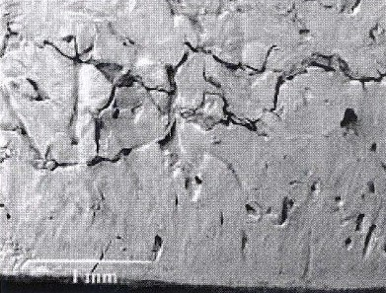
Palmar osteochondral disease, non-adaptive bone disease, or bone bruising are all terms used to describe bone remodeling (osteoclast/osteoblast activity) that cannot keep up with the forces acquired through high speed exercise.
Appropriately diagnosed, and given rest and time, the osteoclasts and osteoblasts catch up; the bone is strengthened, and training can resume.
The conventional layoff for this condition may be inadequate when BPs are present.
With continued, or resumed, high-speed exercise microfractures will continue to develop.
If the osteoclast/osteoblast cycle is interrupted, there is risk for microfractures to coalesce into major fault lines in the bone—and result in bone failure.

Slide 12
The really tricky part?
That BP-treated horse may change hands multiple times before it gets to the trainer at the racetrack, and that trainer can’t possibly know that the horse was treated with BPs.
So there may no opportunity to modify the horse’s management in consideration of an impaired ability for its bones to appropriately respond to training.

Slide 13
Bisphosphonates in horses: There’s a lot we don’t know
Is there a cause and effect relationship between bisphosphonates and fracture?
How long before osteoclast/osteoblast activity returns to normal after a horse is treated with bisphosphonates?
Are there biologic markers that indicate bisphosphonates are having an effect on a horse’s bone?
What is the best way to manage the training of a young horse that has been treated with bisphosphonates?
How long is the period of analgesia?

Slide 14
Bisphosphonates: Regulation and Testing
Testing:
The detection period (the interval during which a substance can be detected after administration) does not correlate with the duration of the drug’s effect.
It is difficult to access young horses when BP treatment related to sales presentation could be expected to occur.
A negative test collected at the wrong time can result in a false sense of security.

Slide 15
Bisphosphonates: The challenge
Effective regulation requires a collaborative effort by all stakeholders: breeders, sales companies, trainers, veterinarians, racing associations, and racing authorities.
One sector acting alone cannot establish meaningful protections for the horse.

